Slide 1


Everything blue is a guide. Delete it before you download.
everything that
goes into one
[smoothie]
Notes:
Slide 1. Hook. Swap in a photo of your empty table or first step. Edit [smoothie].

Slide 2
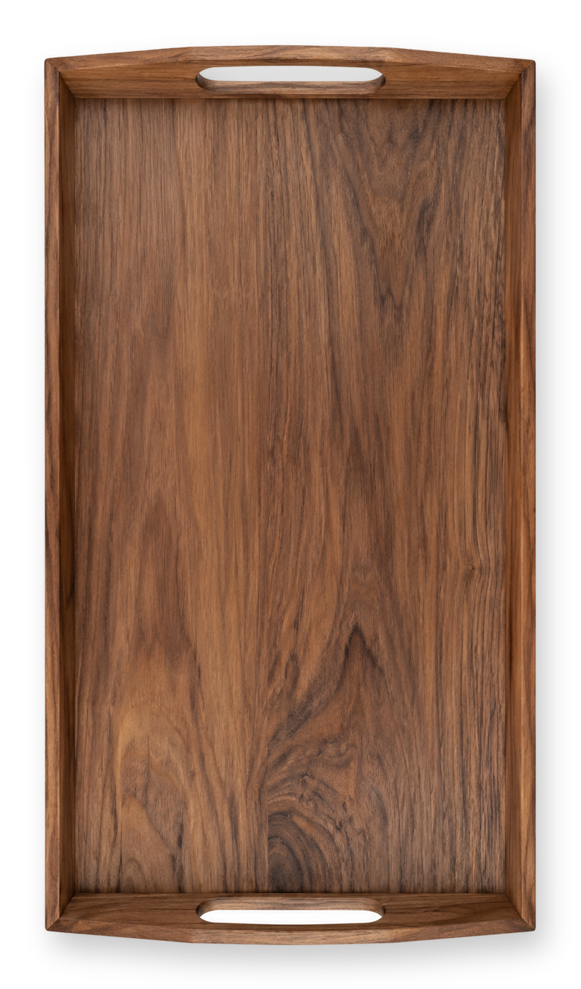


[what's really
inside one?]
[every ingredient]
Notes:
Slide 2. Second hook: Instagram often shows a carousel starting on slide 2, so this one works as a cover on its own. Three material photos sit on the tray. Edit both [bracket] lines.

Slide 3
[fresh watermelon]
Notes:
Slide 3. Material 1 going in: a full-page photo. Name it.

Slide 4


[watermelon]
[oat milk]
[a little honey]
Notes:
Slide 4. All the materials on the tray: a photo and a label for each.

Slide 5


[oat milk]
Notes:
Slide 5. Material 2 or 3 going in: swap in its photo. Name it.

Slide 6




= one
[smoothie]
Notes:
Slide 6. The finished one in the middle of the tray, the materials round it. Edit [smoothie].

Slide 7
[made fresh, to order]
Notes:
Slide 7. The finished one, close: a full-page photo. Edit the line.

Slide 8


Comment
"[KEYWORD]"
[Product name]
Notes:
Slide 8. Swap in a photo of your product. Type its name and your keyword. Caption to start from (CTA in the first two sentences, 3 hashtags): Comment [KEYWORD] and I will send you [the link]. [One line of real context: who it helps or how you use it.] #[tag] #[tag] #[tag]

